Slide 1


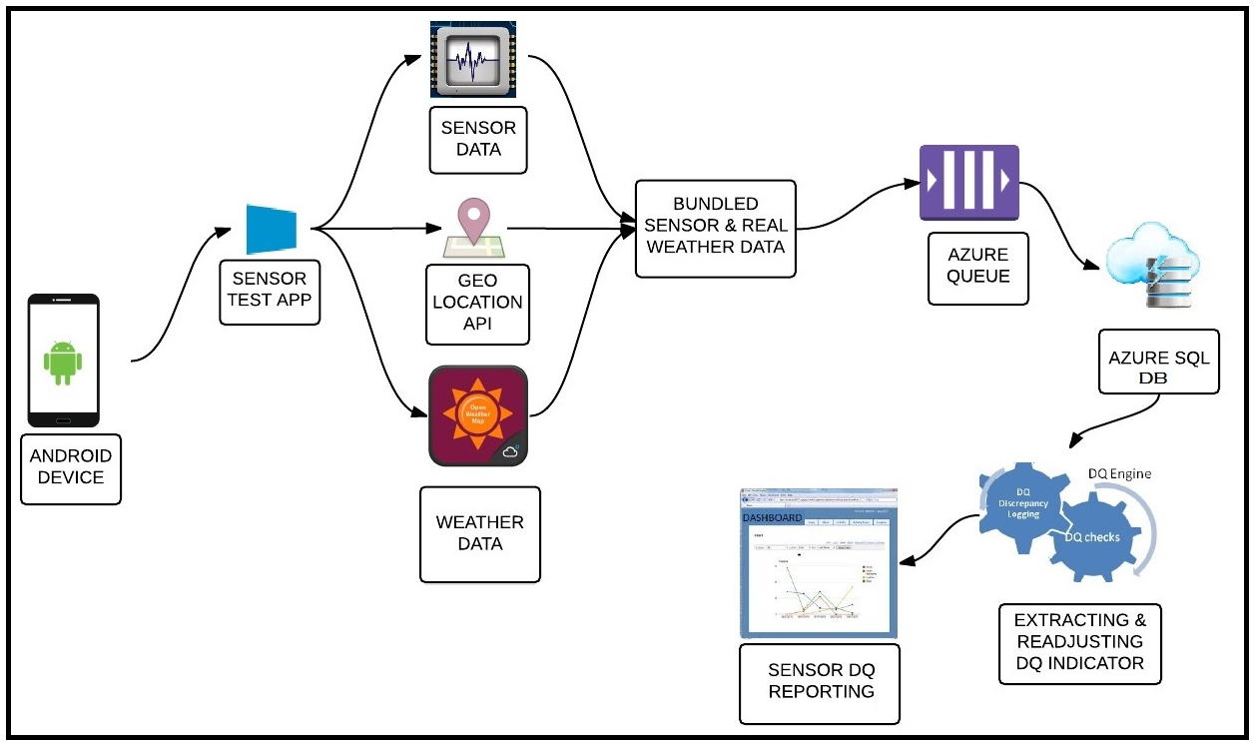
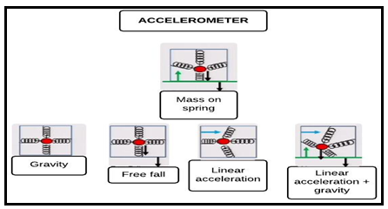

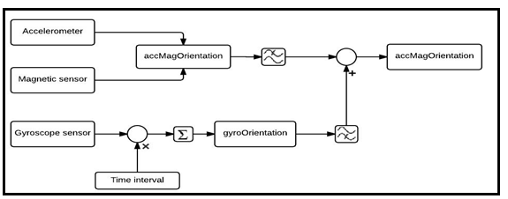
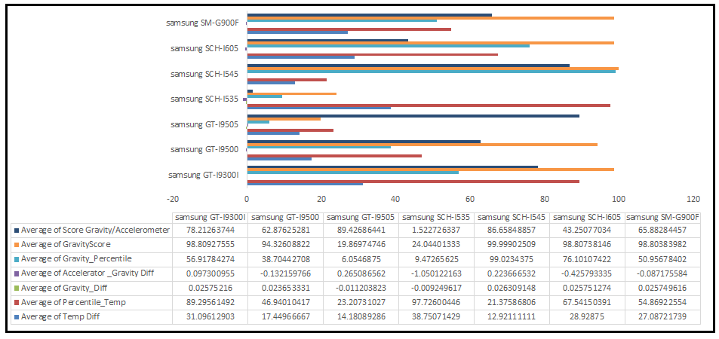
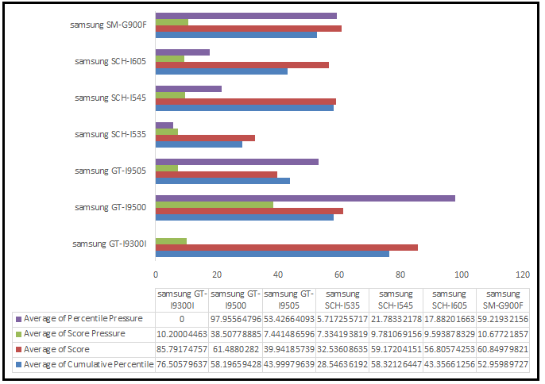
CATEGORIZING AND ADJUSTING DATA QUALITY INDICATORS FOR ANDROID MOTION AND ENVIRONMENT SENSORS
- Ankan Mookherjee, M.S. Computer Science, axm3244@g.rit.edu, 312-508-8693
PROJECT GOALS
ARCHITECTURE AND DESIGN IMPLEMENTATION
RESULTS
Capture motion and environment sensor data of Android Devices
Carry out Data Quality analysis on sensor data to verify accuracy and trustworthiness
Extract Data Quality (DQ) Indicators from the data and perform continuous integration of the data
Figure 1. High-Level Architecture
Figure 2. Sensor Fusion
Figure 3. Technology
Device-to-cloud integration.
Filtering and cleansing data and notification system within the app as well as at the DQ Engine.
More than 1000 instances of collected sensor data from over 11 smartphones and 7 devices within 4 weeks.
Data correlation for different devices and average DQ metric for a smartphone and a particular device.
DQ Metric for an instance of data sent in the overall data collected for the device and that collected from various sources
Samsung Galaxy S4 (SG-I9500) was the most reliable device out of the devices data collected so far.
Sensor fusion helped ease out noise from gyroscope sensor and accelerometer data.
MOTIVATION FOR WORK
Figure 4. Gravity & Accelerometer Sensor
Smartphones produce immensely valuable environment sensor data like Barometer, Relative Humidity and Temperature data which helps in critical scientific pursuits across a wide variety of disciplines.
Motion sensor data produced in Android phones can have calibration error due to damaged device.
Figure 6. Result 1: Motion Sensor & Temperature Sensor Device DQ Indicator
Figure 7. Result 2: Pressure Sensor & Cumulative Device DQ Indicator
FUTURE WORK
DATA QUALITY INDICATOR
Attributes to extract & calculate DQ Metric
Pressure - Ambient Real Time Air pressure vs Air Pressure from Open Weather API
Gravity - Gravity Calculated From Phones Vs Actual Gravity at the latitude
Gravity vs Accelerometer
Magnetic Orientation using Sensor Fusion
Comparison with Gyroscope data
Comparison with Accelerometer data
Battery Température vs Ambient Air Température
To release iPhone, Windows Phone SensorTest App. I have designed the android app using Xamarin with high code reusability factor.
Diagnostic tool within app to get sensor calibration and accuracy information.
Data broker to securely share high quality trustworthy sensor information.
Want to carry out a study on Battery Temperature to predict ambient air temperature.
Carry out further data mining algorithms on collected data and add sensor data for other devices.
WORKFLOW
LESSONS LEARNED
ACKNOWLEDGEMENT
Creating SensorTest app to record Sensor Data.
Device for Cloud integration – Storing device data in Cloud Data Base.
Calculating calibration error for motion sensor data.
Calculating percentile of the average difference of a device and current difference with overall data collected from various devices.
Calculating DQ indicators from percentiles.
Weighing the data from all indicators to create a complete DQ score for a device.
Creating results and continuous integration of DQ Indicator.
Readjustment of DQ indicators with new incoming data by scheduling a time based cron job as worker role.
The Gravity Sensor was unable to supply a lot of useful information. The filters in the phone ensured that Raw data was acquired while the sensors were stationary on a stable desk.
Ambient air temperature comparison using battery temperature was not extremely accurate strategy to generate sensor data quality as room temperature is different from external temperature ( due to data collected indoor). However if trained with larger datasets and accurate ambient temperature information we can device machine learning system which has the potential to determine ambient air temperature and battery diagnosis tool in future.
No correlation was found between phone security and sensor data calibration error due to lack of data from real untrustworthy source. However in theory intrusion detection and smartphone Trojan systems can acquire sensor data use it for unscrupulous purposes. Privacy information can be compromised with unauthorized use, such as by secretly collecting user geolocation and motion sensor information using an app.
In theory, over a period of time sensors should degrade and relay less accurate information, this tool can be used to keep a track on degradation, do a diagnostic device sensor check and recalibration of the sensor devices.
Data from pressure sensor has higher precession than geolocation based weather prediction API’s. I believe if pressure sensor data is securely collected then it can lead to better meteorological data models and micro weather prediction systems as the data collect from android smartphone sensors has more precession.
Professor Leon Reznik, Project Advisor and Project , Coordinator, RIT Computer Science, Ir@cs.rit.edu
Professor Justin Cappos, Department of Computer Security, NYU Polytechnic, cappos@nyu.edu
REFERENCES
[1 ]J. Cappos, L. Wang, R. Weiss, Y. Yang, and Y. Zhuang. BlurSense: Dynamic fine-grained access control for smartphone privacy. Sensors Applications Symposium (SAS), 2014.
[2] ] L. Reznik, "Integral Instrumentation Data Quality Evaluation: the Way to Enhance Safety, Security, and Environment Impact," presented at the 2012 IEEE International Instrumentation and Measurement Technology Conference, Graz, Austria, May 13-16, 2012, 2012.
[3] Sachs, David “Sensor fusion on android devices: A revolution in motion processing”, GoogleTech Talks, 2010
[4] Milette Greg, Stroud Adam, “Professional Android Sensor programming”, ISBN: 978-1-118-18348-9, John Wiley and Sons, 2012
Notes:
Photos should be at least 300dpi, but not more than 5-12 mgs each. Your page is set to be enlarged 200% so do not change the page size to fit another poster size. Please call me and I will help you with a new page size if desired. Lisa 792-4724
Please note this is only a template for you to start with. You can change the font size, colors, column widths and the number of columns

